Slide 1


GLASS TYPE PREDICTION
Cloud Computing
PROJECT BY: ARCHANA
INSTRUCTOR: MAHNAZ FARSHID NIA

Slide 2

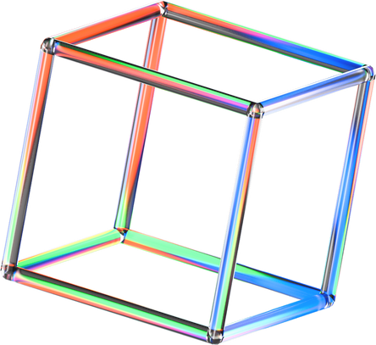

Business Understanding
From USA Forensic Science Service - 6 types of glass
defined in terms of their oxide content (i.e. Na, Fe, K, ca, )
We are predicting the type of glass depending on the level of oxide content.

Slide 3
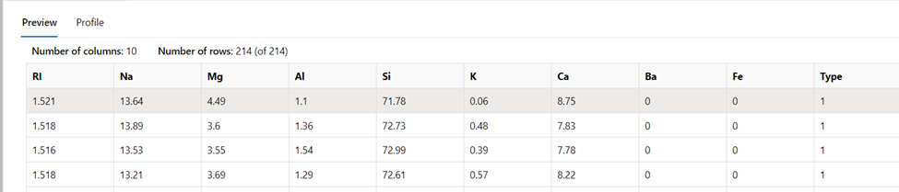
Data Understanding
Number of Observation = 214
Number of features = 10
Features: RI , Na, Mg, AI, Si, k, Ca,Ba,Fe,Type

Slide 4
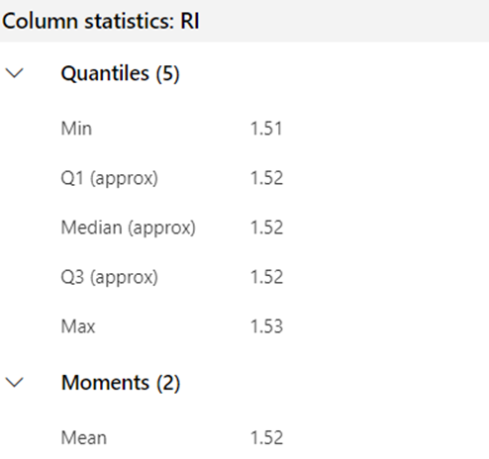
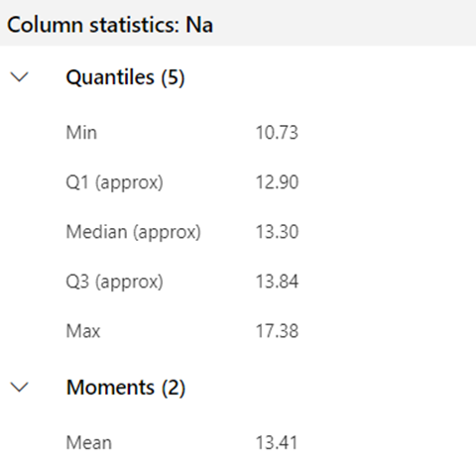
Data Profiling
Min max values
Mean and
Standard
deviation

Slide 5
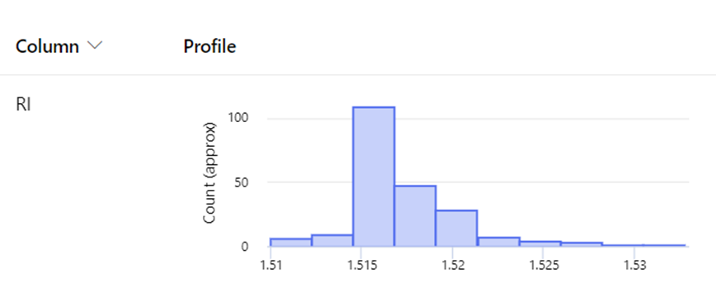
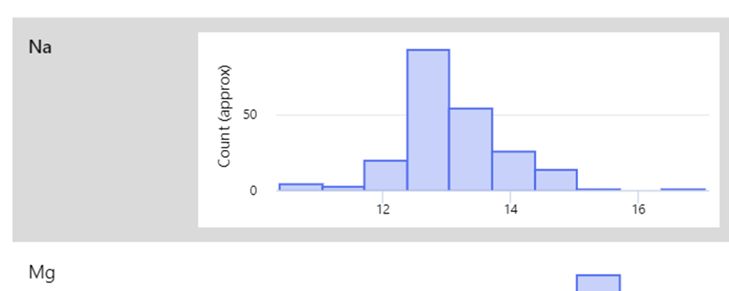
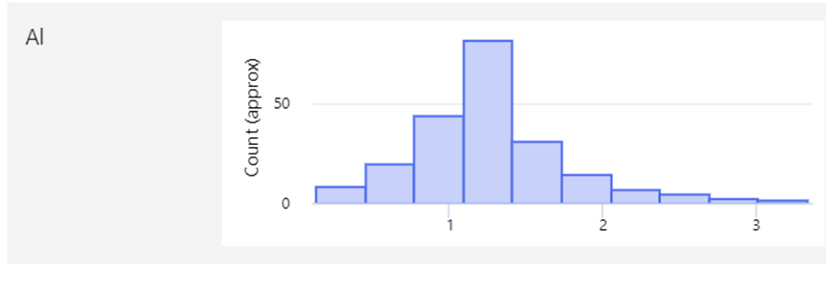
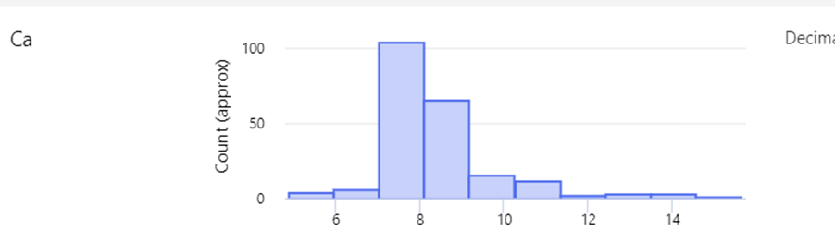
Exploratory Data Analysis

Slide 6
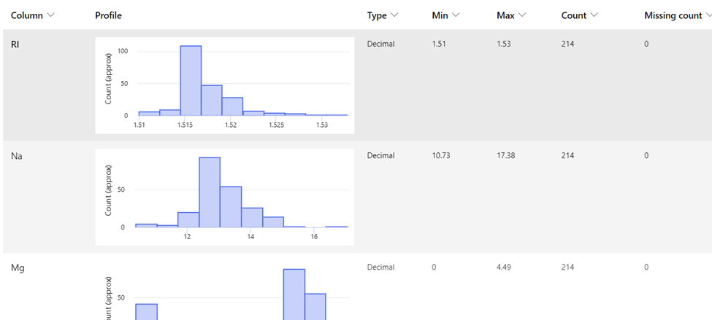
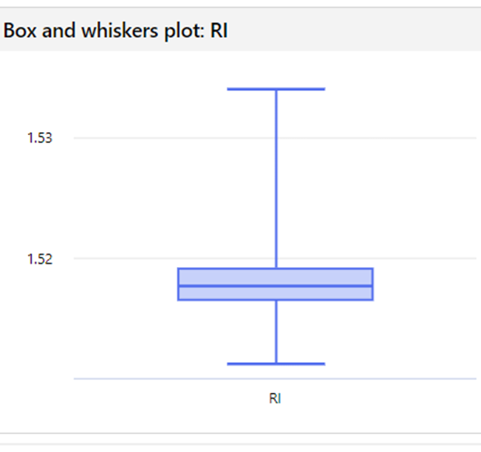
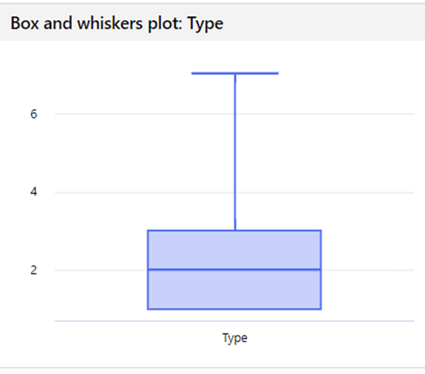
Missing Values
Outliers
No Missing values and Outliers

Slide 7
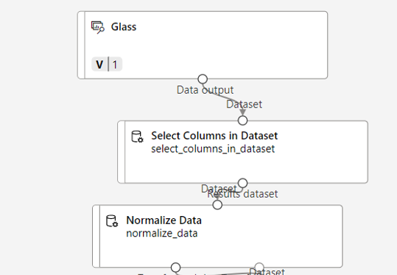
Data Preprocessing
Normalization :
MinMax Scaling

Slide 8
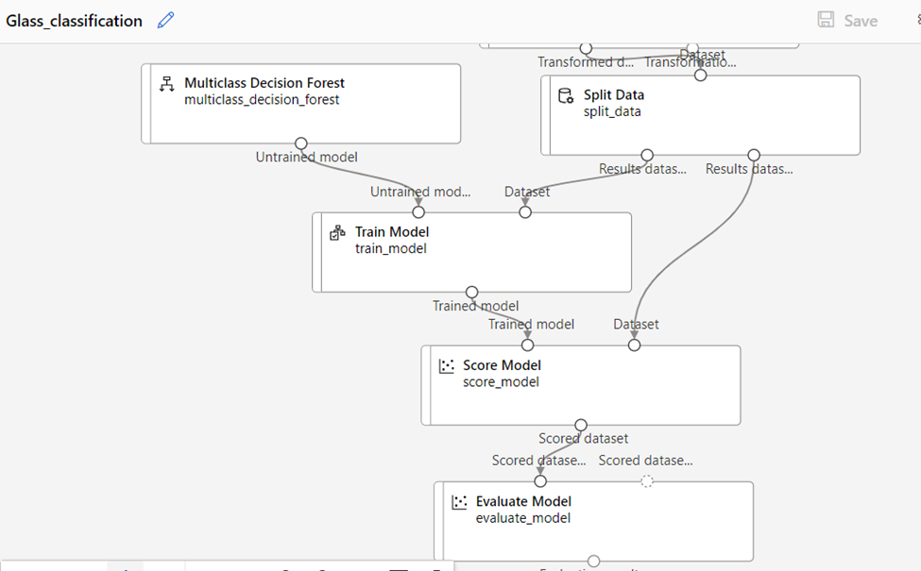
Data splitting and Data Modeling
Multiclass Classification
Model:
Multiclass Decision Forest

Slide 9
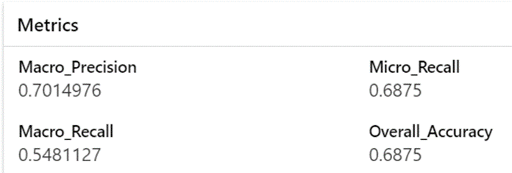
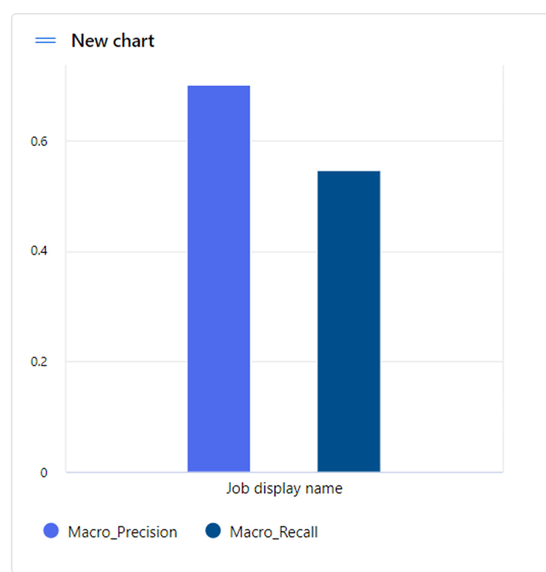
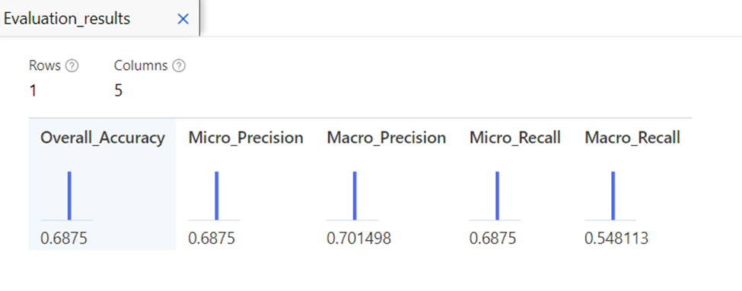
Model Evaluation

Slide 10
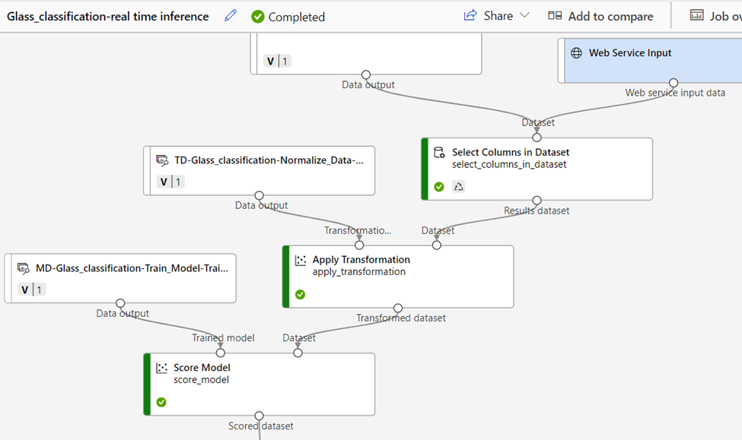
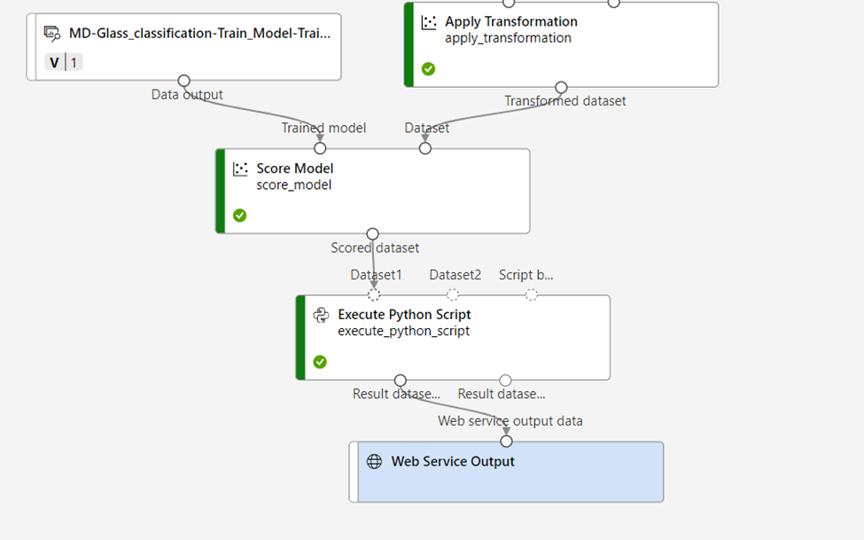
Creating New inference Pipeline

Slide 11
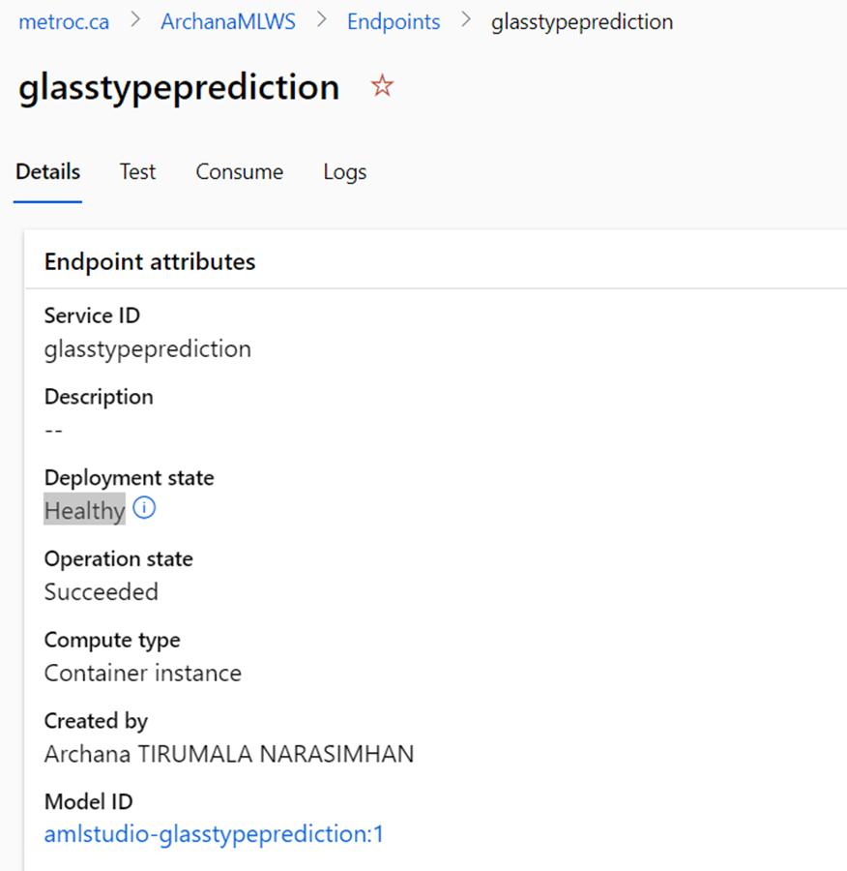
Model Deployment

Slide 12
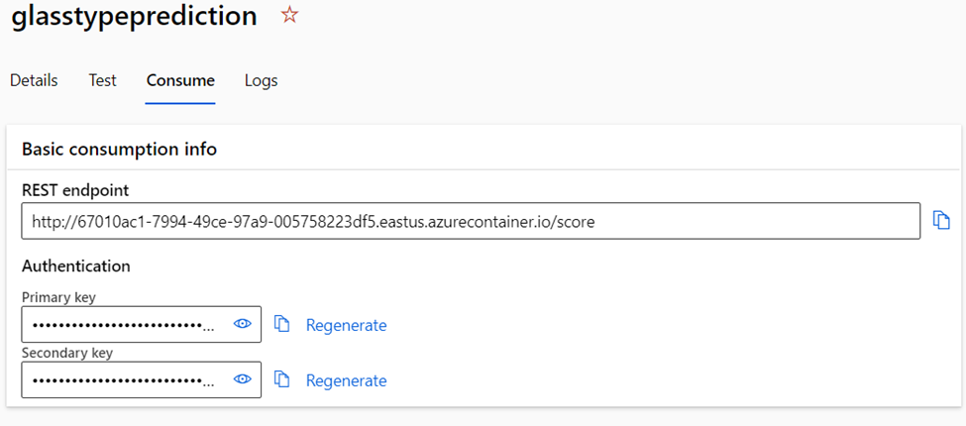
Rest endpoint and Primary key

Slide 13
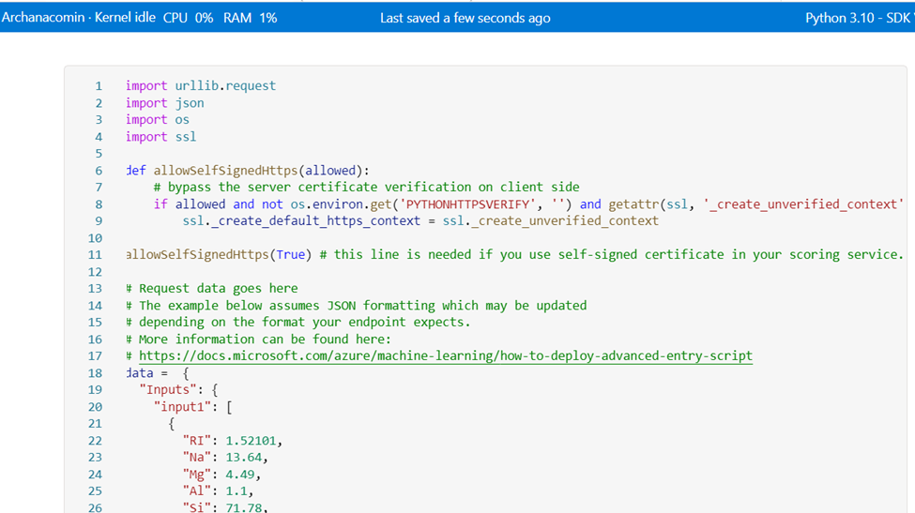
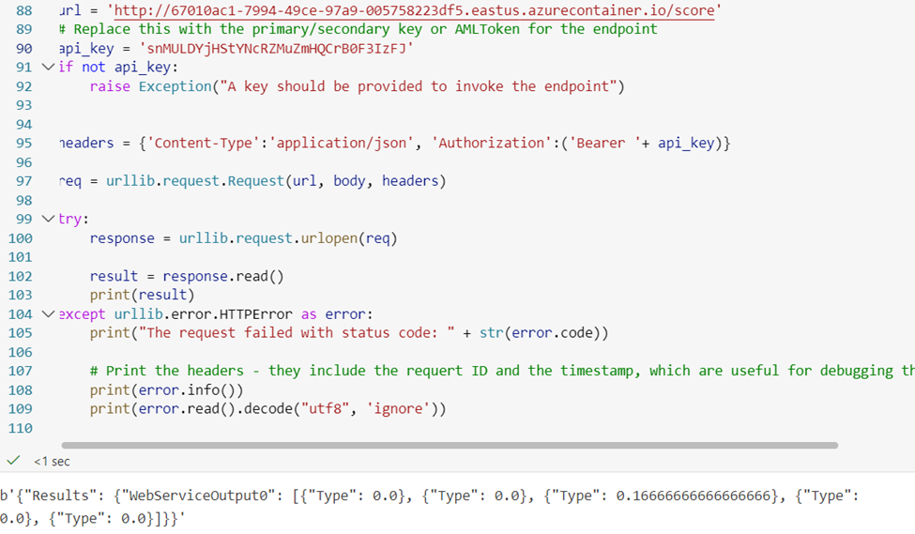
Model Prediction Verification

Slide 14
THANK YOU!!
Cloud Computing and Big Data Analytics
PROJECT: Multiclass classification
PROJECT BY: ARCHANA

